Slide 1


AutoDRIVE-AVLDC Integration
Chinmay Vilas Samak
PhD Candidate, CU-ICAR
csamak@clemson.edu
Tanmay Vilas Samak
PhD Candidate, CU-ICAR
tsamak@clemson.edu

Slide 2
Project Overview
Simulation
Simulated sensors interface with the ADAS/AD stack, which passes controls commands to the simulated vehicle dynamics model.
Emulation
Simulated ground truths bypass the perception stack to interface directly with the planning/control stack, which controls the virtual/physical vehicle.
Stimulation
Physical sensors stimulated through environment simulation, and ADAS/AD stack controls the physical vehicle on the chassis dyno.

Slide 3



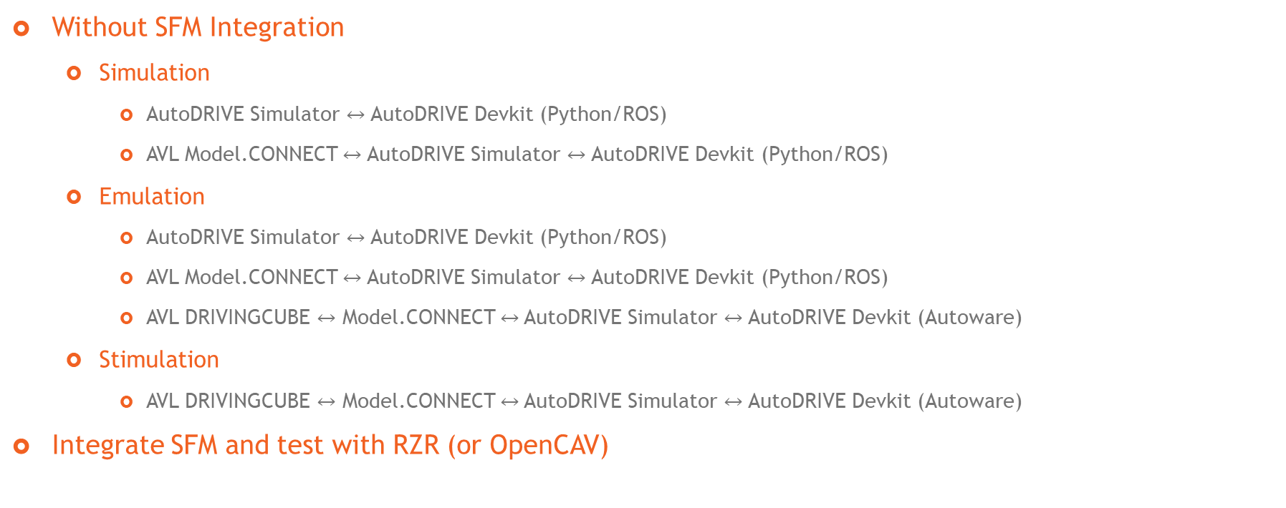
Project Plan
Without SFM Integration
Simulation
AutoDRIVE Simulator $↔$ AutoDRIVE Devkit (Python/ROS)
AVL Model.CONNECT $↔$ AutoDRIVE Simulator $↔$ AutoDRIVE Devkit (Python/ROS)
Emulation
AutoDRIVE Simulator $↔$ AutoDRIVE Devkit (Python/ROS)
AVL Model.CONNECT $↔$ AutoDRIVE Simulator $↔$ AutoDRIVE Devkit (Python/ROS)
AVL DRIVINGCUBE $↔$ Model.CONNECT $↔$AutoDRIVE Simulator $↔$ AutoDRIVE Devkit (Autoware)
Stimulation
AVL DRIVINGCUBE $↔$ Model.CONNECT $↔$AutoDRIVE Simulator $↔$ AutoDRIVE Devkit (Autoware)
Integrate SFM and test with RZR (or OpenCAV)

Slide 4
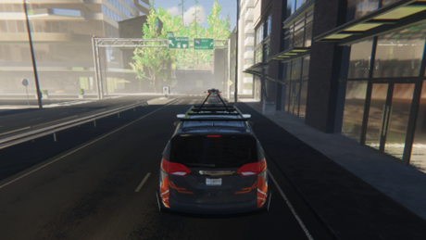
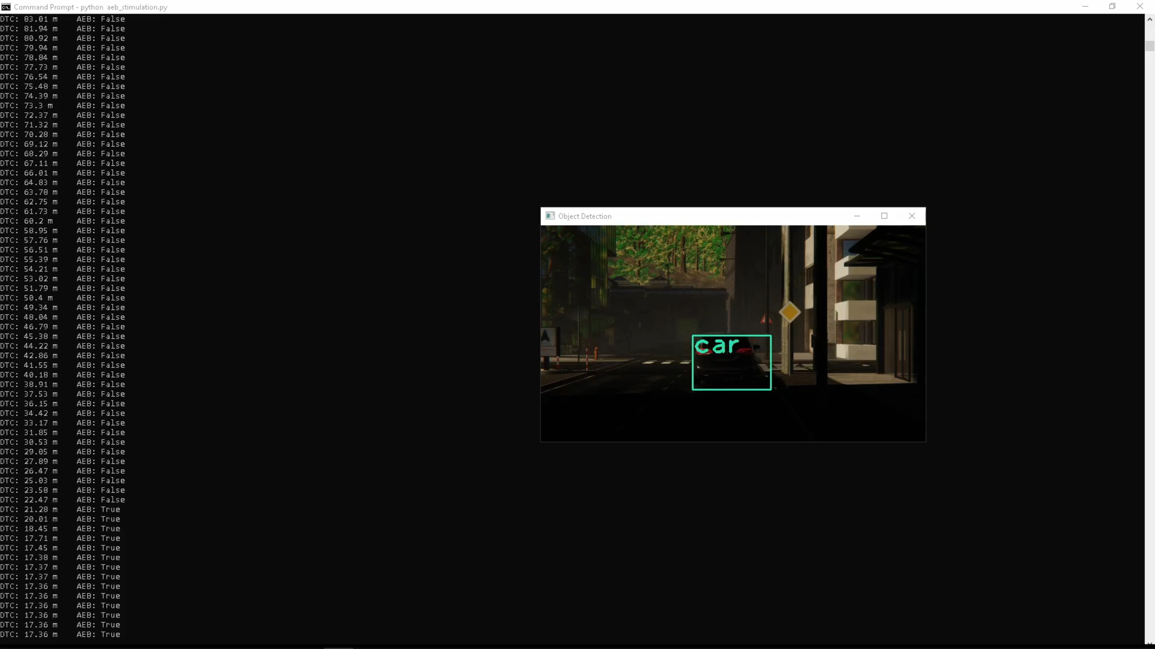





AutoDRIVE Simulator $↔$ AutoDRIVE Devkit
DTC, Camera
Throttle,
Steering,
Brakes,
Handbrakes

Slide 5

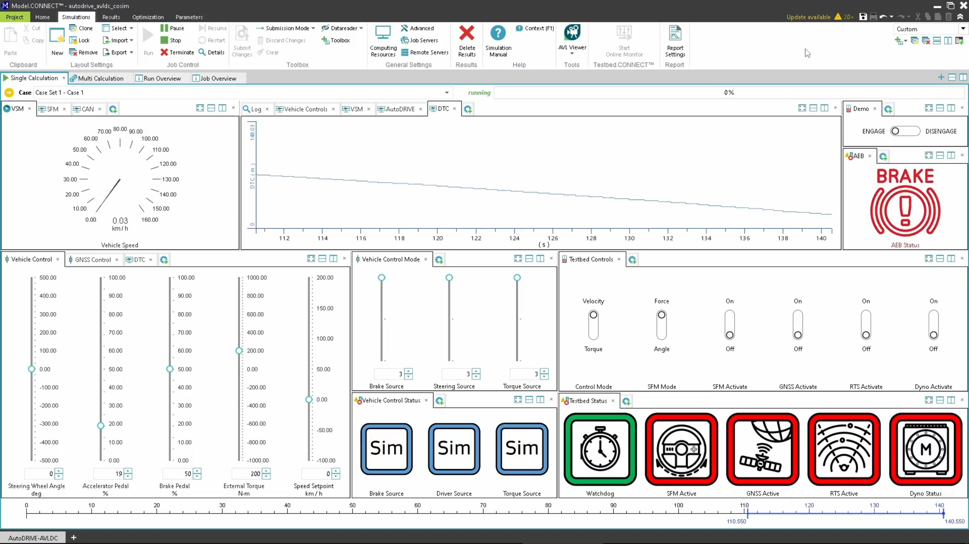
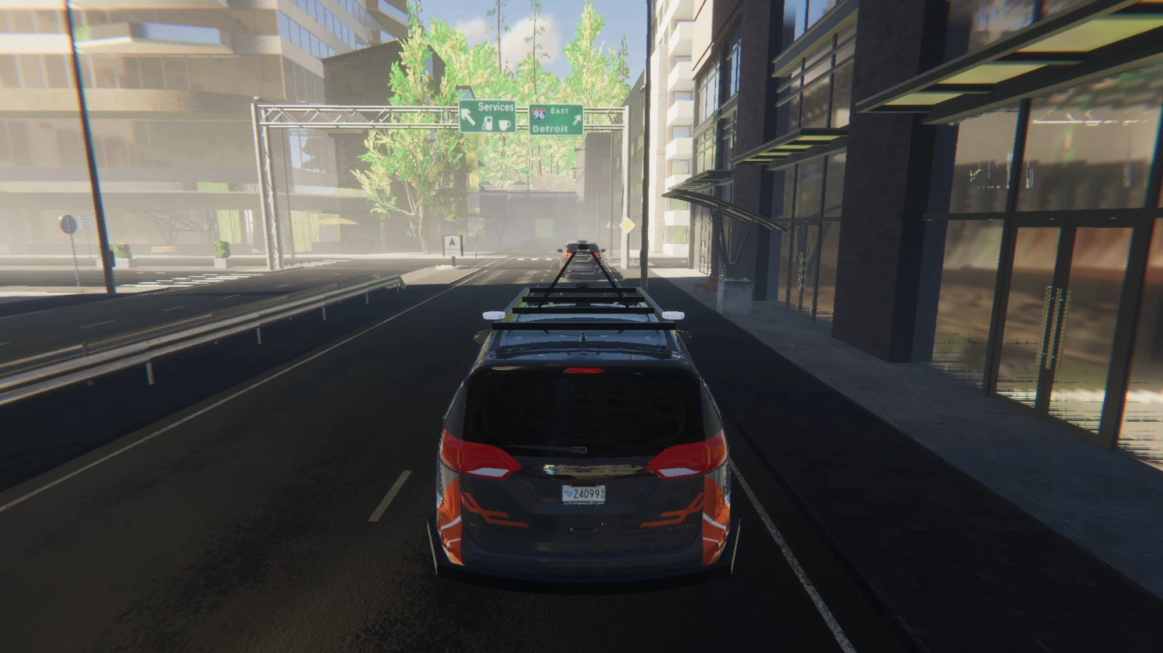



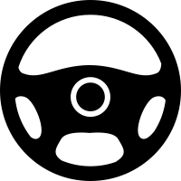


AVL Model.CONNECT $↔$ AutoDRIVE Simulator $↔$ AutoDRIVE Devkit
DTC, Camera
DTC, AEB
States
States
Model.CONNECT™
AVL VSM™
Throttle, Steering,
Brakes, Handbrake

Slide 6
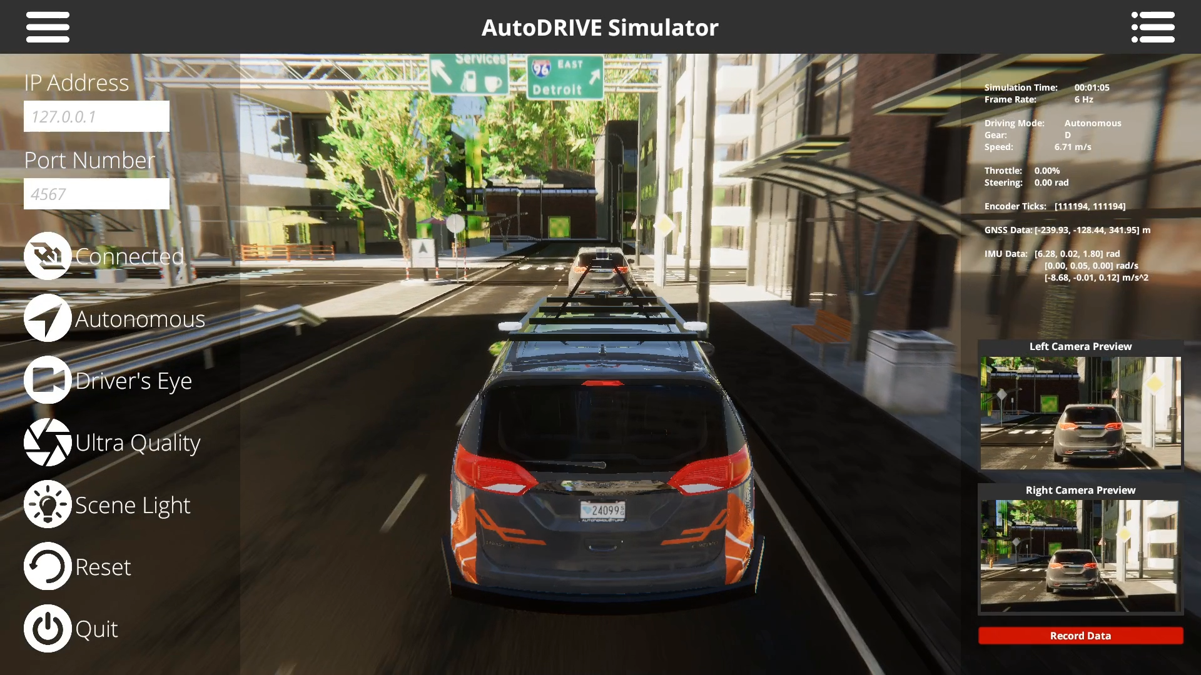


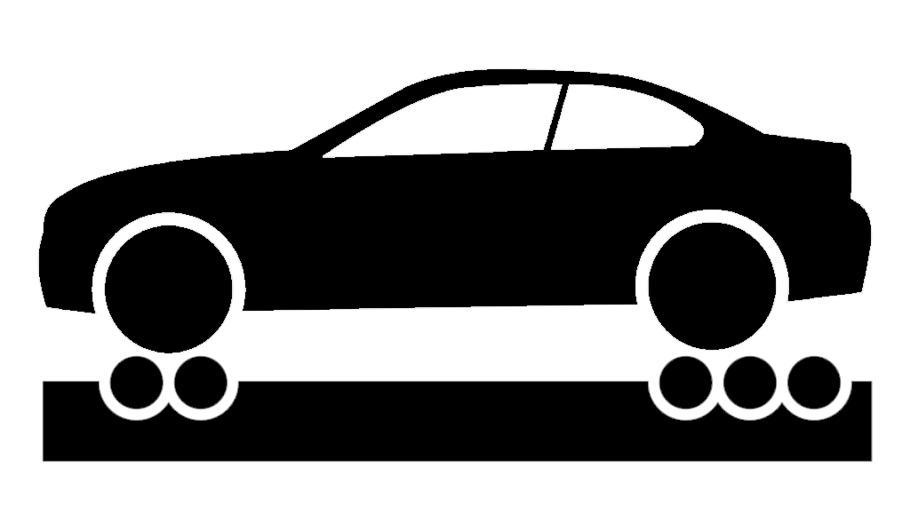

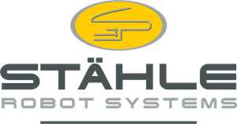

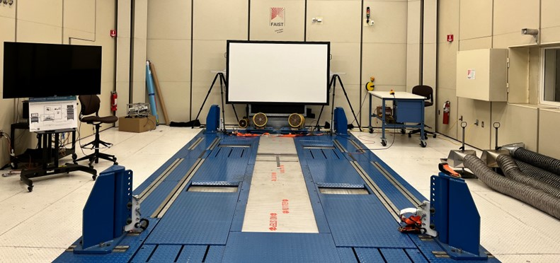
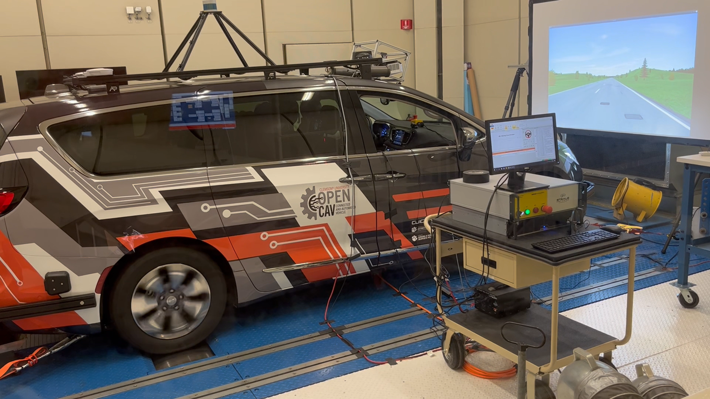




AVL DRIVINGCUBE AVL $↔$ Model.CONNECT $↔$AutoDRIVE Simulator $↔$ AutoDRIVE Devkit
DTC, Camera
DTC, AEB
States, Actions
States
Dyno
SFM
RTS
GNSS
Throttle,
Steering,
Brakes,
Handbrake
Camera Stimulation
Road Load Conditions,
Differential Speeds
AVL DRIVINGCUBE™

